Slide 1



EV Vehicle/Charging Demand Prediction
Name: BIKASH NAIK
STUD_ID: STU6644751bcfc821715762459
AICTE ID: INTERNSHIP_17504079746855162636342

Slide 2

Learning Objectives
Key Learning Objectives
Data-Driven Forecasting: To learn how to use historical data to
build a predictive model for future
trends, specifically in the context of EV
adoption.
Solving a Real-World Problem: To understand how data science
can be applied to solve critical
infrastructure challenges, like planning
for EV charging demand.
Building a Complete Solution: To gain experience in creating an
end-to-end project, from data analysis
and model building to a user-friendly,
interactive dashboard.
Driving Sustainability: To demonstrate the role of AI and green
skills in promoting proactive planning for
a sustainable future.
GOAL
Source :
www.freepik.com/

Slide 3






Tools and Technology used
Programming Language – Python
Used throughout for data analysis, model training, and dashboard deployment.
2. Data Handling – Pandas & NumPy
Pandas: For data cleaning, transformation, and time-series feature engineering.
NumPy: Used in calculating rolling means, growth slopes, and other numeric operations.
3. Machine Learning – Scikit-learn
RandomForestRegressor: Trained for time-series forecasting of EV adoption.
RandomizedSearchCV: Tuned model parameters for better accuracy.
LabelEncoder: Converted categorical features (like counties) into numeric form.
4. Model Persistence – joblib
Saved the trained model and encoders as .pkl files for easy app integration.
5. Visualization – Matplotlib, Seaborn & Plotly
Seaborn & Matplotlib: Used for exploratory data visualization.
Plotly: Powered interactive charts in the Streamlit dashboard.
6. Deployment – Streamlit
Developed a responsive web app for end-users to visualize and forecast EV demand at the county level.
7. Environment – Jupyter Notebook
Used for experimentation, model building, and initial EDA.

Slide 4
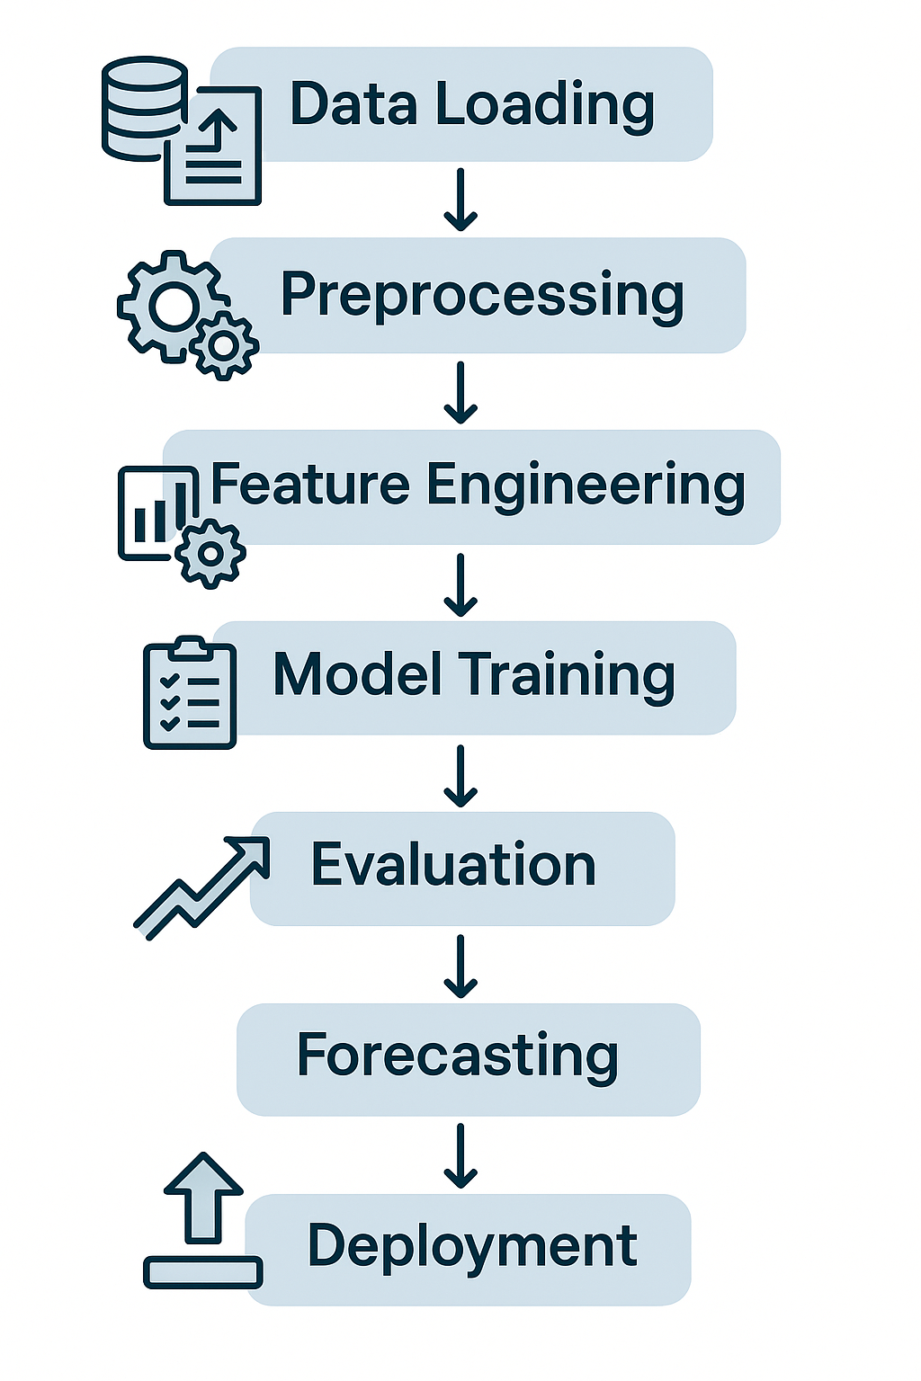
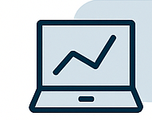
Methodology
Our Method: A Full Data Science Pipeline
Our project followed a rigorous 7-step data science pipeline to ensure
our model is robust and reliable. This process is a clear, step-by-step
flow from initial data to a final deployed solution.
We started with Data Preparation and cleaning.
We then focused on Model Training to teach our model to recognize
historical patterns.
Finally, we created a dashboard for easy Deployment of the model’s
insights.
Here are the seven specific steps we followed:
Data Loading & Initial Analysis
Data Preprocessing & Outlier Handling
Exploratory Data Analysis (EDA)
Feature Engineering
Model Preparation & Training
Model Evaluation
Multi-County Forecasting & Ranking

Slide 5
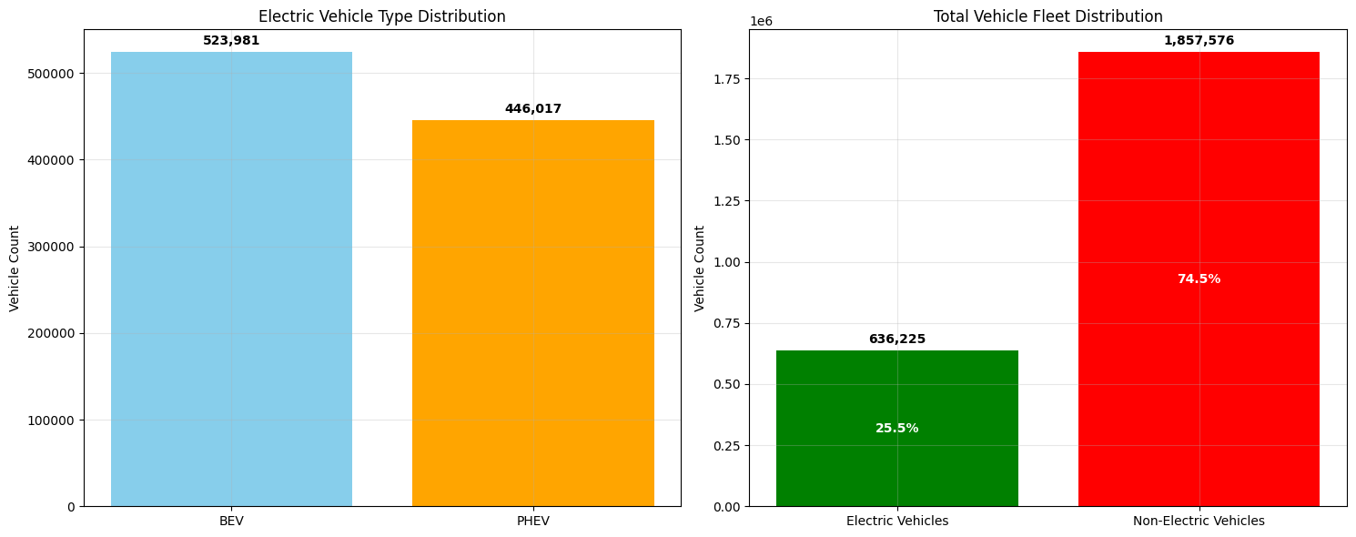
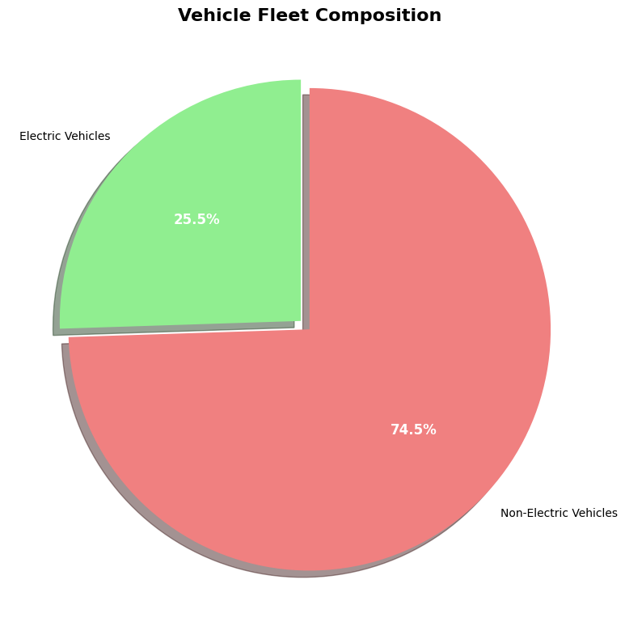
Methodology
Deep Dive: Data Preparation & Analysis
We started with a dataset of 20,819 records, and after cleaning and handling 2,476 outliers, the final dataset
for training was 12,573 records.
Our initial analysis showed that Electric Vehicles (EVs) make up a small, but rapidly growing 25.5% of the total
vehicle fleet in our dataset. The other 74.5% are non-electric vehicles.
Within the EV category, Battery Electric Vehicles (BEVs) are the most common with 523,981 records, followed
by Plug-in Hybrid Electric Vehicles (PHEVs) with 446,017 records.
These key insights from our analysis directly guided the features we engineered for our model.

Slide 6
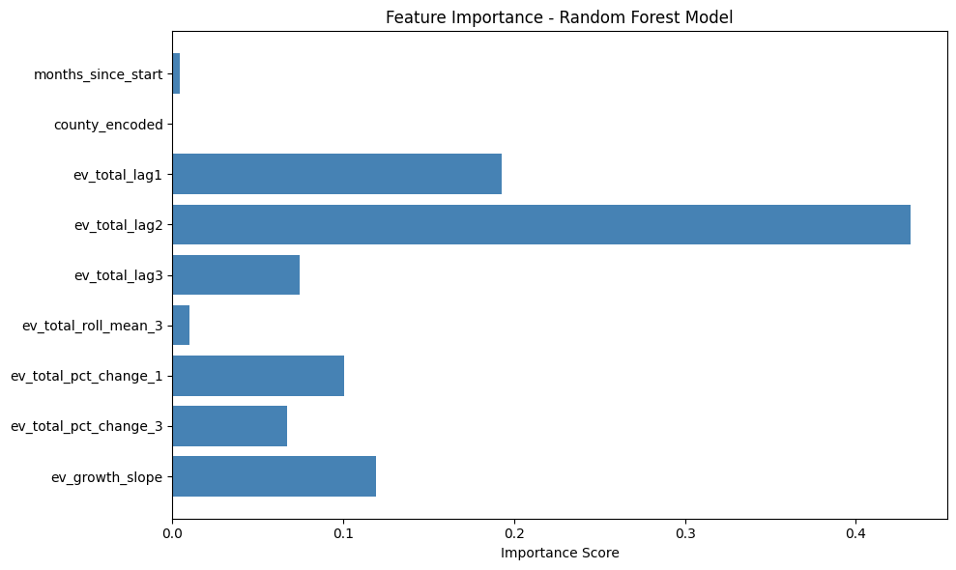
Methodology
Deep Dive: The Key to Our Model's Accuracy
Feature Engineering: The strength of our model
comes from the custom features we created to
capture real-world trends. We specifically engineered
features to capture temporal patterns, such as:
1. Lag Features: Past EV counts from 1, 2, and 3
months ago (ev_total_lag1, ev_total_lag2,
ev_total_lag3).
2. Trend Analysis: A 3-month rolling average
(ev_total_roll_mean_3) and a 6-month growth slope
(ev_growth_slope) to identify growth momentum.
Most Important Features: Our model, a Random
Forest Regressor, was tuned using
RandomizedSearchCV. The analysis revealed that
lag features (ev_total_lag1 and ev_total_lag2) were
the most crucial predictors of future EV adoption.
Conclusion: This shows our model's predictions are
highly reliant on recent historical patterns, which is a
powerful and logical insight for forecasting.

Slide 7

Problem Statement:
The Big Challenge: Preparing for the EV Revolution
The Opportunity: Electric Vehicles are the future, but their
rapid adoption is creating a critical challenge for urban
planners.
The Problem: "Inadequate planning [for charging stations]
can lead to bottlenecks, impacting user satisfaction and
hindering sustainability goals.“
The Goal: To build a predictive model that accurately
forecasts future EV adoption. This allows us to place
charging infrastructure strategically, where it's needed most,
to support this revolution.
The Dataset: This project uses a real-world dataset from the Washington State Department of Licensing. The
data provides monthly counts of registered vehicles (EVs and non-EVs) from 2017 to 2024 and includes
details like vehicle type and geographical location.

Slide 8
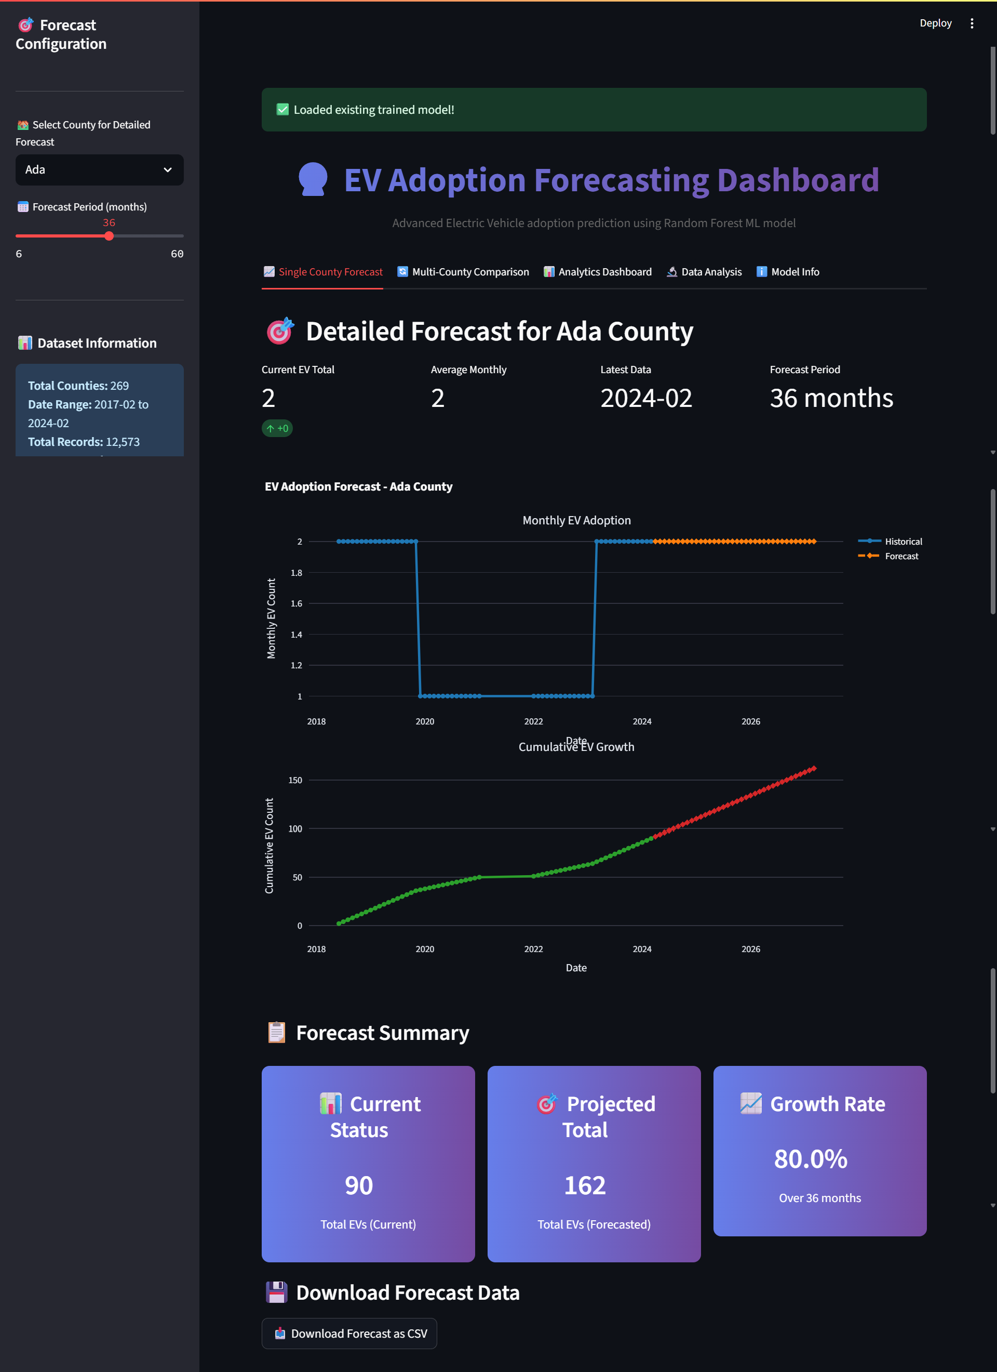

Solution:
Our Complete Solution
The core of our solution is a Random Forest Regressor
model that has been rigorously trained and optimized to
forecast future EV adoption.
We built an interactive web application using Streamlit to
deploy this model. This serves as a user-friendly
dashboard for urban planners and policymakers.
The dashboard allows users to:
Generate detailed forecasts for EV adoption in a
single, specific county.
Conduct multi-county comparisons to understand
regional growth trends.
Access a comprehensive analytics dashboard with
state-wide EV statistics.
The full source code for this project is available on
GitHub, allowing for transparency and future collaboration.
GitHub Repository Link: https://github.com/Bikashnaik07/EV-Demand-Forecasting

Slide 9
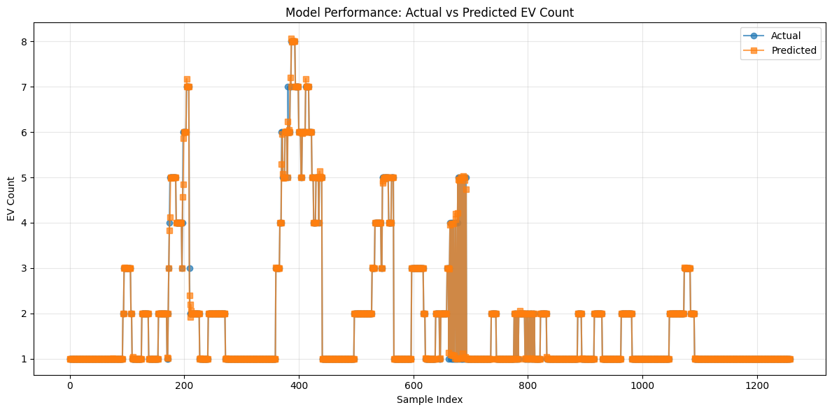
Screenshot of Output:
Model Performance
To ensure our model is reliable, we first
evaluated its performance on historical
data it had not seen before.
The model achieved a remarkably high
R² score of 0.9984, indicating that it
explains over 99.8% of the variability in
the EV count.
The MAE (Mean Absolute Error) was
0.01 and the RMSE (Root Mean
Squared Error) was 0.06, showing that
our predictions are extremely close to
the actual historical values.
The graph below visually confirms this accuracy, with the predicted values (orange line) almost perfectly
matching the actual values (blue line).

Slide 10
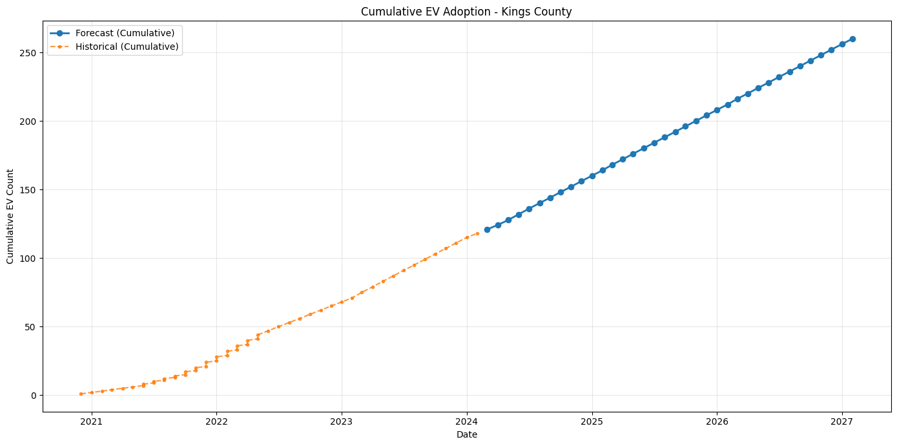
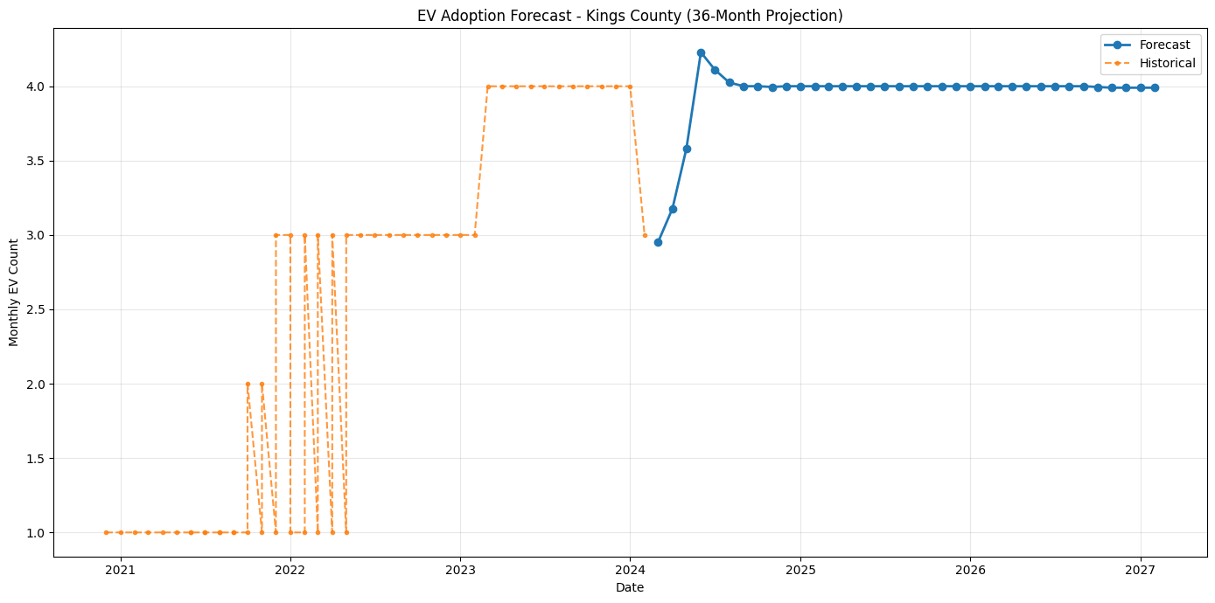
Screenshot of Output:
Forecasting for a Single County
This output demonstrates the model’s practical application for local planners.
The first graph shows the historical monthly EV additions (orange line) and the model's forecast (blue line),
projecting a steady trend of new vehicle registrations.
The second graph is key for long-term planning. It visualizes the total cumulative EV count, showing the
projected growth curve over a 36-month forecast period for a specific county like Kings County.

Slide 11
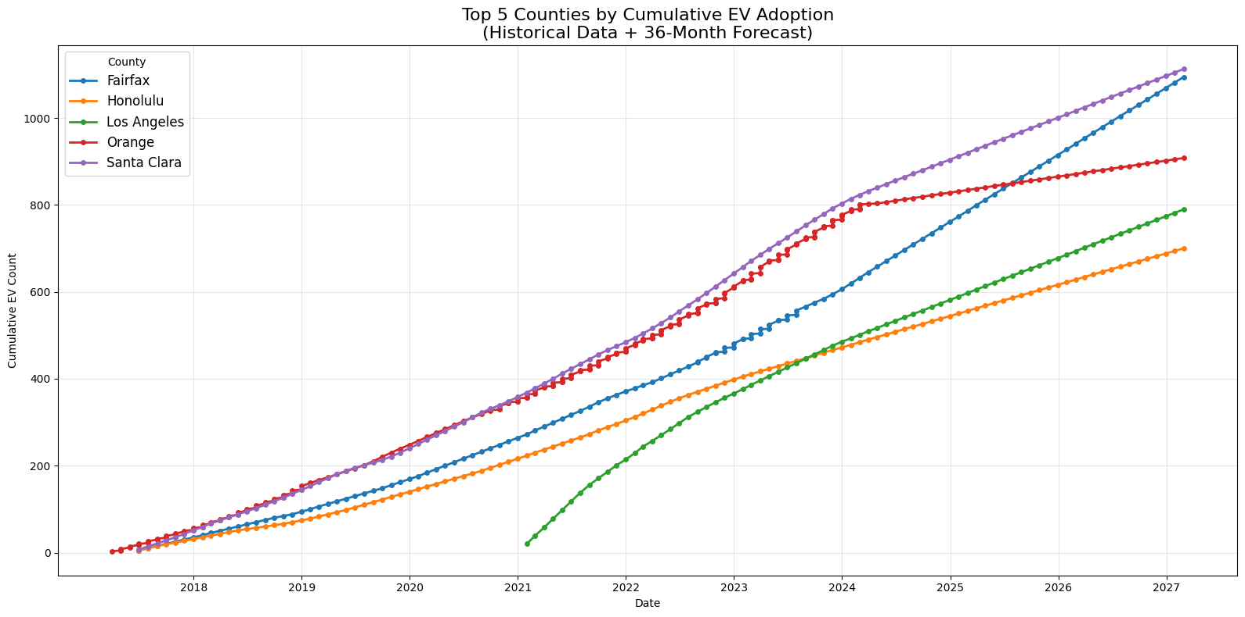
Screenshot of Output:
Strategic Analysis: Multi-County Comparison
Our dashboard allows for a powerful
multi-county comparison, helping
stakeholders make strategic decisions
on a regional level.
The graph shows the projected cumulative
EV growth for the top-performing
counties, such as Santa Clara, Fairfax,
and Orange, over a 36-month period.
This tool allows a city planner or energy
company to quickly compare growth
trajectories and identify the regions that will
require charging infrastructure most urgently.

Slide 12

Conclusion:
Project Summary:
Problem: We successfully addressed the challenge of forecasting EV adoption to
help urban planners make informed decisions on infrastructure.
Solution: We built a highly accurate Random Forest Regressor model that
achieved an R² score of 0.9984 and a low RMSE of 0.06.
Key Insight: The model's accuracy is primarily driven by engineered
time-series features, specifically the EV counts from the previous two months.
Final Deliverable: The project was packaged into an interactive Streamlit
dashboard that provides a user-friendly interface with actionable insights
for planning.
Future Scope:
Alternate Algorithms: To handle potential non-linear data more effectively, we
could explore other algorithms like SVR (Support Vector Regressor) to see if they
can offer even greater accuracy or different insights.
Data Enrichment: The model could be enhanced by incorporating additional external data,
such as local EV policy changes, economic indicators, or charging station locations, to make
the forecasts more robust.

